Slide 1
Chapter 14:
Exception Handling

Slide 2
Objectives
In this chapter, you will:
  Learn what an exception is
  Handle exceptions within a program
  Use a try/catch block to handle exceptions
  Become familiar with C++ exception classes
  Create your own exception classes
  Throw and rethrow an exception
  Explore stack unwinding
C++ Programming: From Problem Analysis to Program Design, Sixth Edition

Slide 3
Introduction
Exception: undesirable event detectable during program execution
Code to handle exceptions depends on the type of application being developed
  May or may not want the program to terminate when an exception occurs
Can add exception-handling code at point where an error can occur
C++ Programming: From Problem Analysis to Program Design, Sixth Edition
Notes:
example, division by zero is an exception. Similarly, trying to open an input file that does not exist is an exception, as is an array index that goes out of bounds

Slide 4
Handling Exceptions Within a Program
Assert function:
  Checks if an expression meets certain condition(s)
  If conditions are not met, it terminates the program
Example: division by 0
  If divisor is zero, assert terminates the program with an error message
C++ Programming: From Problem Analysis to Program Design, Sixth Edition

Slide 5
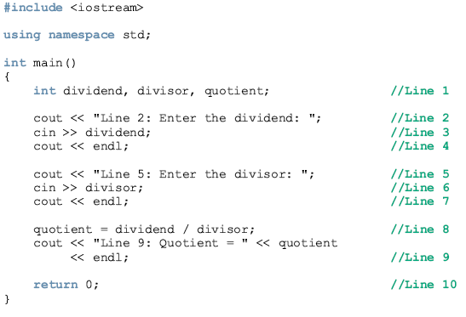
Example
C++ Programming: From Problem Analysis to Program Design, Sixth Edition

Slide 6
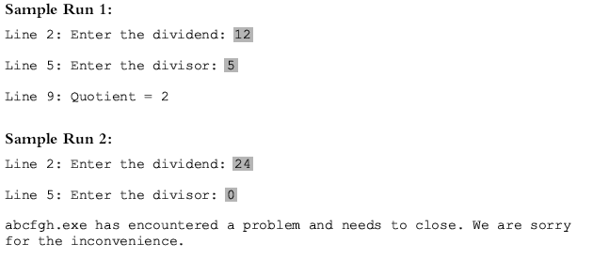
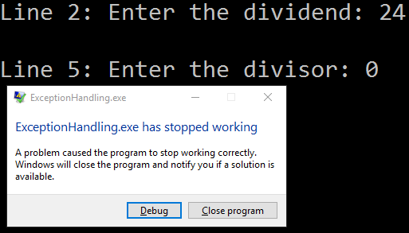
C++ Programming: From Problem Analysis to Program Design, Sixth Edition

Slide 7
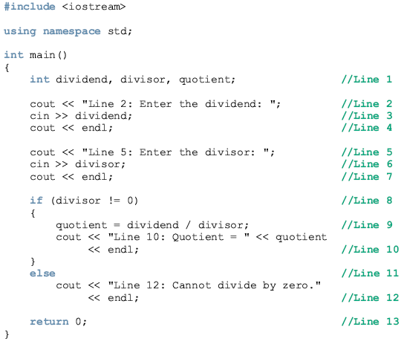
Example
C++ Programming: From Problem Analysis to Program Design, Sixth Edition

Slide 8
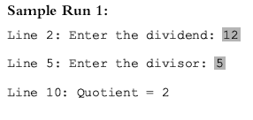
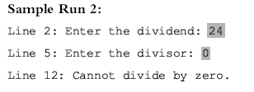
C++ Programming: From Problem Analysis to Program Design, Sixth Edition

Slide 9
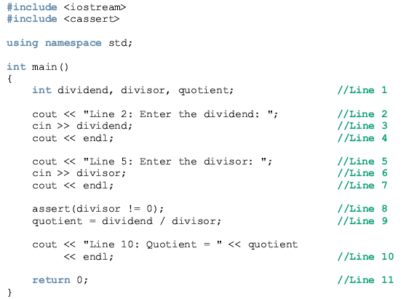
Example
C++ Programming: From Problem Analysis to Program Design, Sixth Edition

Slide 10
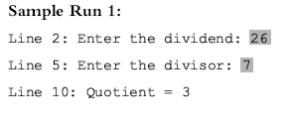
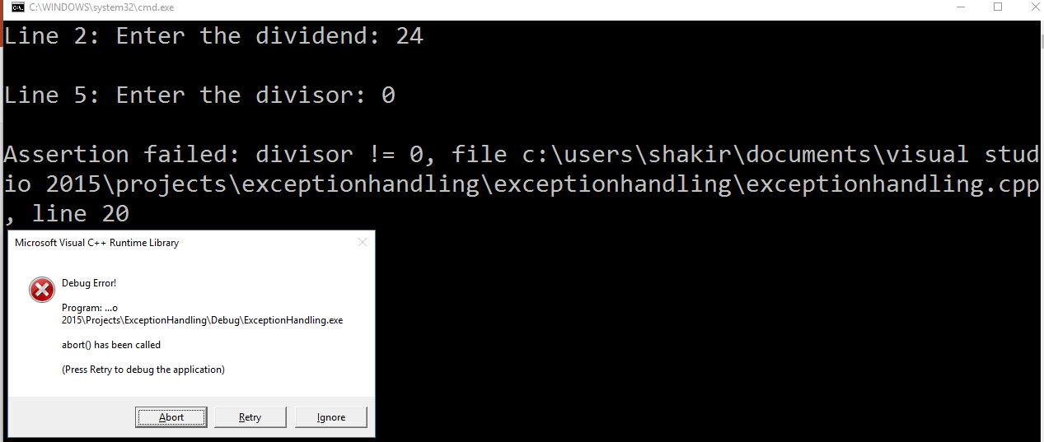
C++ Programming: From Problem Analysis to Program Design, Sixth Edition

Slide 11
C++ Mechanisms
of Exception Handling
try/catch block: used to handle exceptions
Exception must be thrown in a try block and caught by a catch block
C++ provides support to handle exceptions via a hierarchy of classes
C++ Programming: From Problem Analysis to Program Design, Sixth Edition

Slide 12
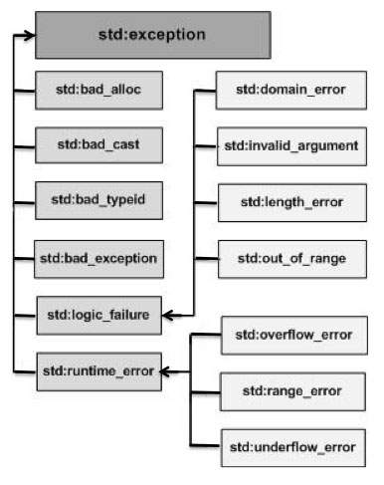
hierarchy
C++ Programming: From Problem Analysis to Program Design, Sixth Edition

Slide 13
Exception | Description
std::exception | An exception and parent class of all the standard C++ exceptions.
std::bad_alloc | This can be thrown by new.
std::bad_cast | This can be thrown by dynamic_cast.
std::bad_exception | This is useful device to handle unexpected exceptions in a C++ program
std::bad_typeid | This can be thrown by typeid.
std::logic_error | An exception that theoretically can be detected by reading the code.
std::domain_error | This is an exception thrown when a mathematically invalid domain is used
std::invalid_argument | This is thrown due to invalid arguments.
std::length_error | This is thrown when a too big std::string is created
std::out_of_range | This can be thrown by the at method from for example a std::vector and std::bitset<>::operator[]().
std::runtime_error | An exception that theoretically can not be detected by reading the code.
std::overflow_error | This is thrown if a mathematical overflow occurs.
std::range_error | This is occured when you try to store a value which is out of range.
std::underflow_error | This is thrown if a mathematical underflow occurs.
hierarchy
C++ Programming: From Problem Analysis to Program Design, Sixth Edition

Slide 14
try/catch Block
Statements that may generate an exception are placed in a try block
The try block also contains statements that should not be executed if an exception occurs
try block is followed by one or more catch blocks
C++ Programming: From Problem Analysis to Program Design, Sixth Edition

Slide 15
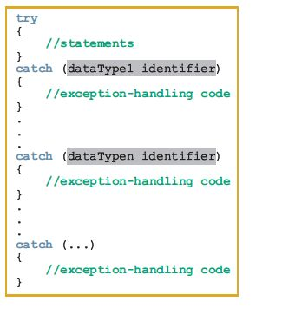
try/catch Block (cont’d.)
C++ Programming: From Problem Analysis to Program Design, Sixth Edition

Slide 16
try/catch Block (cont’d.)
catch block:
  Specifies the type of exception it can catch
  Contains an exception handler
If the heading of a catch block contains ... (ellipses) in place of parameters
  Block can catch exceptions of all types
If no exception is thrown in a try block
  All catch blocks are ignored
  Execution resumes after the last catch block
C++ Programming: From Problem Analysis to Program Design, Sixth Edition

Slide 17
try/catch Block (cont’d.)
If an exception is thrown in a try block
  Remaining statements (in block) are ignored
Program searches catch blocks in order, looking for an appropriate exception handler
  If the type of thrown exception matches the parameter type in one of the catch blocks:
    Code of that catch block executes
    Remaining catch blocks are ignored
C++ Programming: From Problem Analysis to Program Design, Sixth Edition

Slide 18
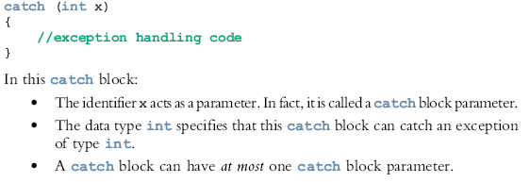
try/catch Block (cont’d.)
A catch block can have at most one catch block parameter
  catch block parameter becomes a placeholder for the value thrown
C++ Programming: From Problem Analysis to Program Design, Sixth Edition

Slide 19
Throwing an Exception
For try/catch to work, the exception must be thrown in the try block
General syntax:
    throw exception;
  where expression is a constant value, variable, or object
Object being thrown can be a specific object or an anonymous object
In C++, an exception is a value
C++ Programming: From Problem Analysis to Program Design, Sixth Edition

Slide 20
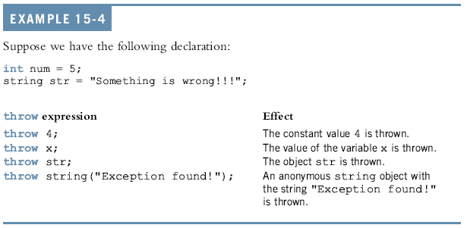
Throwing an Exception:
C++ Programming: From Problem Analysis to Program Design, Sixth Edition

Slide 21
Order of catch Blocks
catch block can catch:
  All exceptions of a specific type
  All types of exceptions
A catch block with an ellipsis (. . .) catches any type of exception
  If used, it should be the last catch block of that sequence
Be careful about the order in which you list catch blocks
C++ Programming: From Problem Analysis to Program Design, Sixth Edition

Slide 22
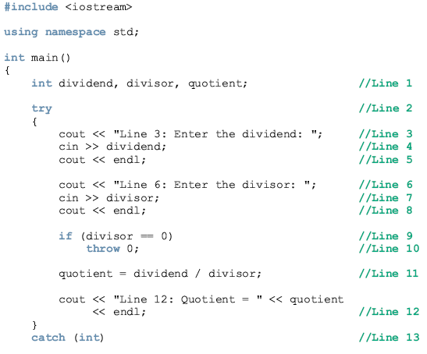
Using try/catch Blocks in a Program:
C++ Programming: From Problem Analysis to Program Design, Sixth Edition

Slide 23
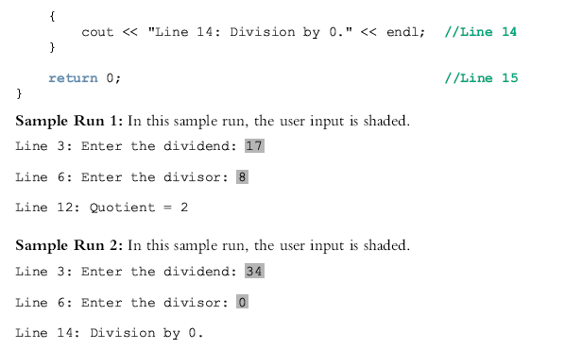
C++ Programming: From Problem Analysis to Program Design, Sixth Edition

Slide 24

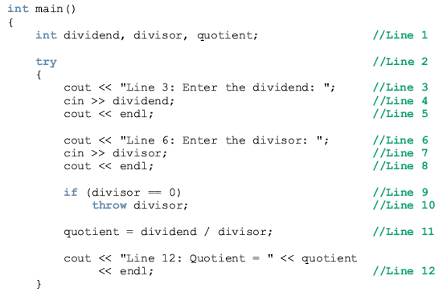
Example
C++ Programming: From Problem Analysis to Program Design, Sixth Edition

Slide 25
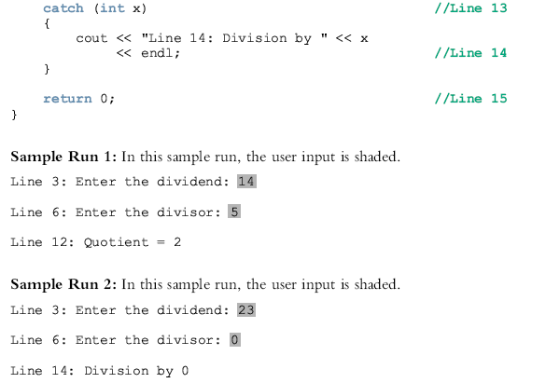
C++ Programming: From Problem Analysis to Program Design, Sixth Edition

Slide 26
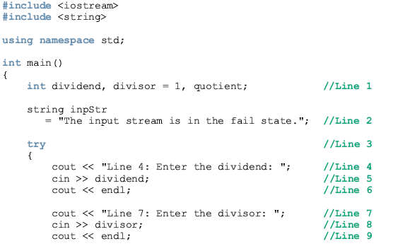
Example: how to handle division by zero, division by a negative integer, and input failure exceptions.
C++ Programming: From Problem Analysis to Program Design, Sixth Edition

Slide 27
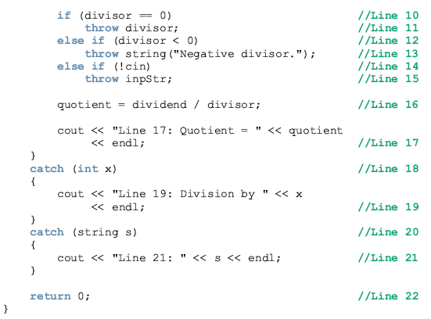
C++ Programming: From Problem Analysis to Program Design, Sixth Edition

Slide 28
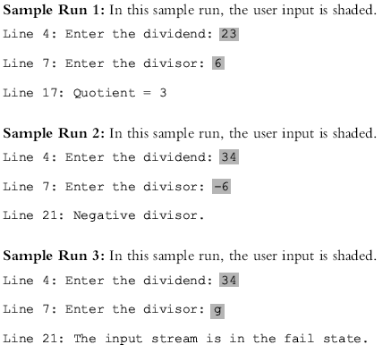
C++ Programming: From Problem Analysis to Program Design, Sixth Edition

Slide 29
Using C++ Exception Classes
C++ provides support to handle exceptions via a hierarchy of classes
what function: returns a string containing the exception object thrown by C++’s built-in exception classes
class exception: base class of the exception classes provided by C++
  Contained in the header file exception
C++ Programming: From Problem Analysis to Program Design, Sixth Edition

Slide 30
Using C++ Exception Classes (cont’d.)
Two subclasses of exception (defined in stdexcept):
  logic_error includes subclasses:
    invalid_argument: for use when illegal arguments are used in a function call
    out_of_range: string subscript out of range error
    length_error: if a length greater than the maximum allowed for a string object is used
  runtime_error includes subclasses:
    overflow_error and underflow_error
C++ Programming: From Problem Analysis to Program Design, Sixth Edition

Slide 31
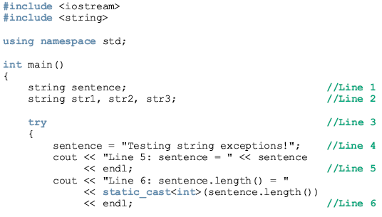
Example : exceptions out_of_range and length_error
C++ Programming: From Problem Analysis to Program Design, Sixth Edition

Slide 32
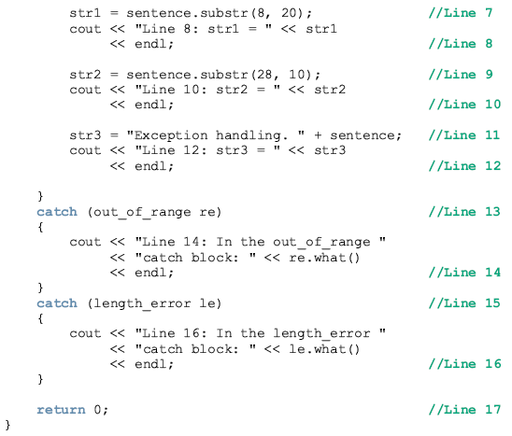
C++ Programming: From Problem Analysis to Program Design, Sixth Edition
Notes:
If a length larger then the maximum length allowed for a
string is used, then the length_error exception is generated. If the operator new cannot
allocate memory space, this operator throws a bad_alloc exception

Slide 33
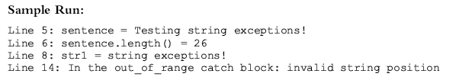
C++ Programming: From Problem Analysis to Program Design, Sixth Edition

Slide 34
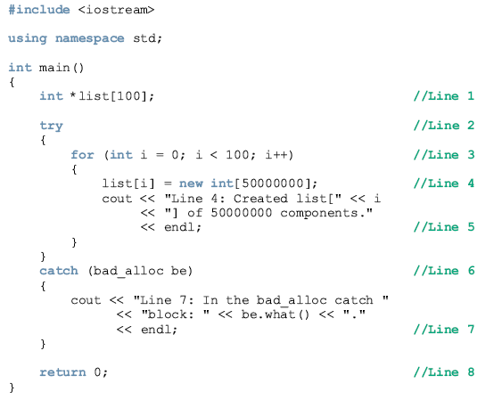
Example : exception bad_alloc
C++ Programming: From Problem Analysis to Program Design, Sixth Edition
Notes:
The preceding program works as follows. The statement in Line 1 declares list to be an
array of 100 pointers. The body of the for loop in Line 3 is designed to execute 100
times. For each iteration of the for loop, the statement in Line 4 uses the operator new to
allocate an array of 50000000 components of type int. As shown in the sample run, the
operator new is able to create eight arrays of 50000000 components each. In the ninth
iteration, the operator new is unable to create the array and throws a bad_alloc
exception. This exception is caught and processed by the catch block in Line 6. Notice
that the expression be.what() returns the string bad allocation. (Moreover, the
string returned by be.what() is SDK dependent. Some SDKs might return the string
bad_alloc.) After the statement in Line 7 executes, control exits the try/catch block,
and the statement in Line 8 terminates the program.

Slide 35
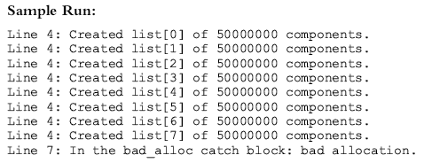
Line 4: Created list[0] of 50000000 components.
Line 4: Created list[1] of 50000000 components.
Line 4: Created list[2] of 50000000 components.
Line 4: Created list[3] of 50000000 components.
Line 4: Created list[4] of 50000000 components.
Line 4: Created list[5] of 50000000 components.
Line 4: Created list[6] of 50000000 components.
Line 4: Created list[7] of 50000000 components.
Line 4: Created list[8] of 50000000 components.
Line 7: In the bad_alloc catch block: bad allocation.
C++ Programming: From Problem Analysis to Program Design, Sixth Edition

Slide 36
Creating Your Own Exception Classes
Can create your own exception classes to handle specific exceptions
  C++ uses the same mechanism to process these exceptions
throw statement: used to throw your own exceptions
Any class can be an exception class
  How you use the class makes it an exception class
C++ Programming: From Problem Analysis to Program Design, Sixth Edition

Slide 37
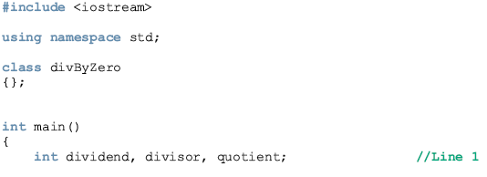
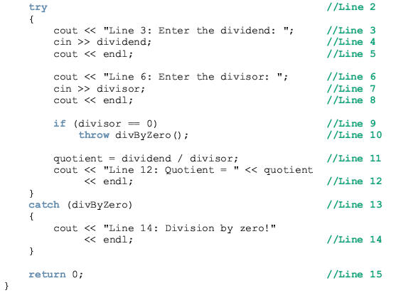
Creating Your Own Exception Classes
C++ Programming: From Problem Analysis to Program Design, Sixth Edition
Notes:
If the user enters 0 for the divisor, the
state-ment in Line 10 throws an anonymous object of the class divByZero.
The class divByZero has no members, so we cannot really do anything with
the thrown object. Therefore, in the catch block in Line 13, we specify only the data type
name without the parameter name.

Slide 38
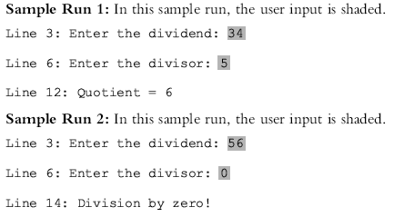
Creating Your Own Exception Classes
C++ Programming: From Problem Analysis to Program Design, Sixth Edition
Notes:
If the user enters 0 for the divisor, the
state-ment in Line 10 throws an anonymous object of the class divByZero.
The class divByZero has no members, so we cannot really do anything with
the thrown object. Therefore, in the catch block in Line 13, we specify only the data type
name without the parameter name.

Slide 39
Creating Your Own Exception Classes (cont’d.)
Exception class with member variables typically includes:
  Constructors
  The function what
C++ Programming: From Problem Analysis to Program Design, Sixth Edition

Slide 40
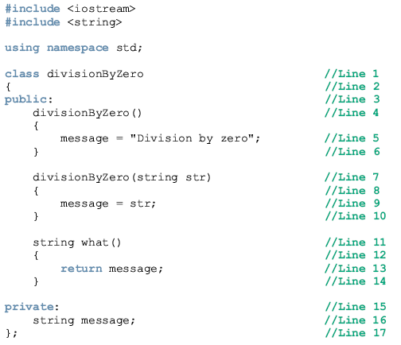

Slide 41
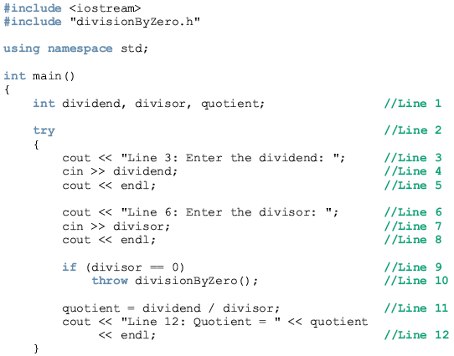
Example

Slide 42
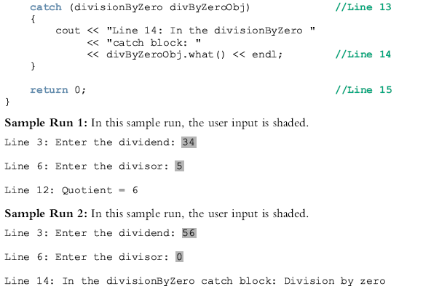
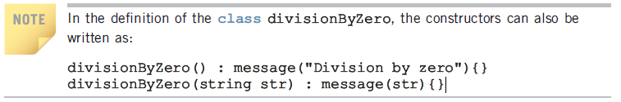

Slide 43
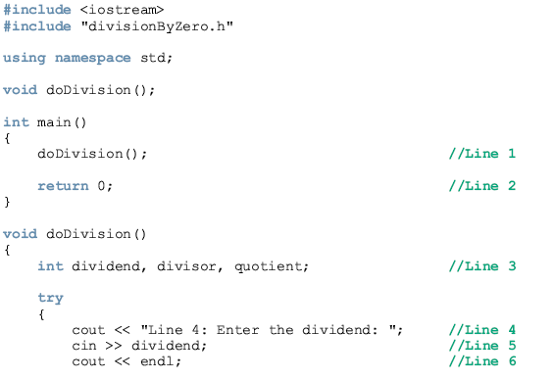
Example
Notes:
In the programs in Examples 16-11 and 16-12, the data manipulation is done in the
function main. Therefore, the exception is thrown, caught, and processed in the function
main. The program in Example 16-13 uses the user-defined function doDivision to
manipulate the data. Therefore, the exception is thrown, caught, and processed in the
function doDivision.

Slide 44
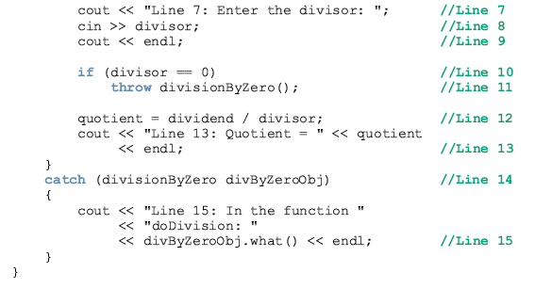
Notes:
In the programs in Examples 16-11 and 16-12, the data manipulation is done in the
function main. Therefore, the exception is thrown, caught, and processed in the function
main. The program in Example 16-13 uses the user-defined function doDivision to
manipulate the data. Therefore, the exception is thrown, caught, and processed in the
function doDivision.

Slide 45
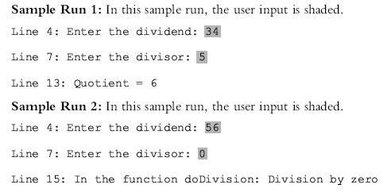
Notes:
In the programs in Examples 16-11 and 16-12, the data manipulation is done in the
function main. Therefore, the exception is thrown, caught, and processed in the function
main. The program in Example 16-13 uses the user-defined function doDivision to
manipulate the data. Therefore, the exception is thrown, caught, and processed in the
function doDivision.

Slide 46
Rethrowing and Throwing an Exception
When an exception occurs in a try block, control immediately passes to one of the catch blocks, which either:
  Handles the exception, or partially processes the exception, then rethrows the same exception
  Rethrows another exception for the calling environment to handle
This allows you to provide exception-handling code all in one place
C++ Programming: From Problem Analysis to Program Design, Sixth Edition
Notes:
In the programs in Examples 16-11 and 16-12, the data manipulation is done in the
function main. Therefore, the exception is thrown, caught, and processed in the function
main. The program in Example 16-13 uses the user-defined function doDivision to
manipulate the data. Therefore, the exception is thrown, caught, and processed in the
function doDivision.

Slide 47


Rethrowing and Throwing an Exception (cont’d.)
Syntax to rethrow an exception caught by a catch block:
  If the same exception is to be rethrown:
  If a different exception is to be thrown
  where expression is a constant value, variable, or object
C++ Programming: From Problem Analysis to Program Design, Sixth Edition

Slide 48
Rethrowing and Throwing an Exception (cont’d.)
Object being thrown can be:
  A specific object
  An anonymous object
A function specifies the exceptions it throws in its heading using the throw clause
C++ Programming: From Problem Analysis to Program Design, Sixth Edition
Notes:
A function specifies the exceptions it throws (to be handled somewhere) in its heading
using the throw clause. For example, the following function specifies that it throws
exceptions of type int, string, and divisionByZero, in which divisionByZero is
the class, as defined previously.

Slide 49
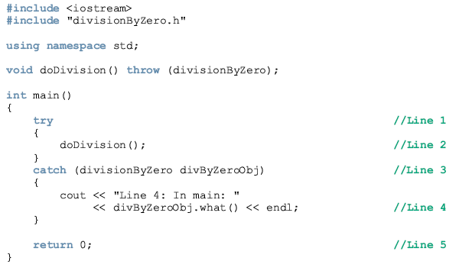
Example: // Handling an exception, in the main function, thrown by another
// function. The function throws the same exception object.

Slide 50
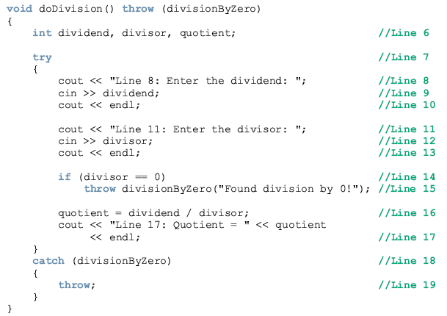

Slide 51
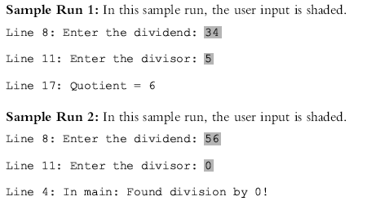

Slide 52
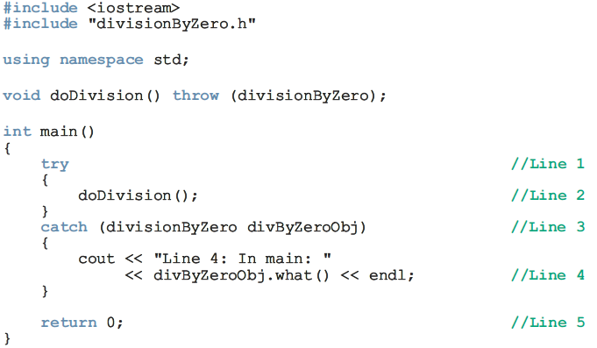
Example: // Handling exception, in the main function, thrown by another
// function. The function throws a different exception object..

Slide 53
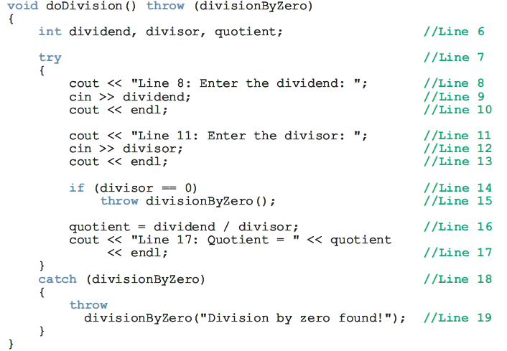
Example: // Handling exception, in the main function, thrown by another
// function. The function throws a different exception object..

Slide 54
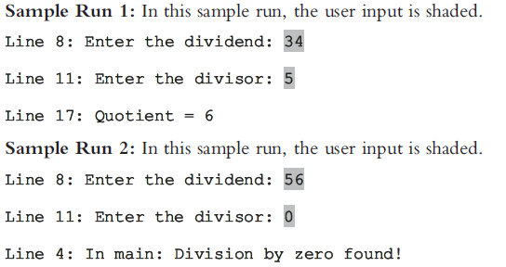
Example: // Handling exception, in the main function, thrown by another
// function. The function throws a different exception object..

Slide 55
Exception-Handling Techniques
When an exception occurs, the programmer usually has three choices:
  Terminate the program
  Include code to recover from the exception
  Log the error and continue
C++ Programming: From Problem Analysis to Program Design, Sixth Edition

Slide 56
Terminate the Program
In some cases, it is best to terminate the program when an exception occurs
Example: if an input file does not exist when the program executes
  There is no point in continuing with the program
  Program can output an appropriate error message and terminate
C++ Programming: From Problem Analysis to Program Design, Sixth Edition

Slide 57
Fix the Error and Continue
In some cases, you will want to handle the exception and let the program continue
Example: a user inputs a letter instead of a number
  The input stream will enter the fail state
  Can include the necessary code to keep prompting the user to input a number until the entry is valid
C++ Programming: From Problem Analysis to Program Design, Sixth Edition

Slide 58
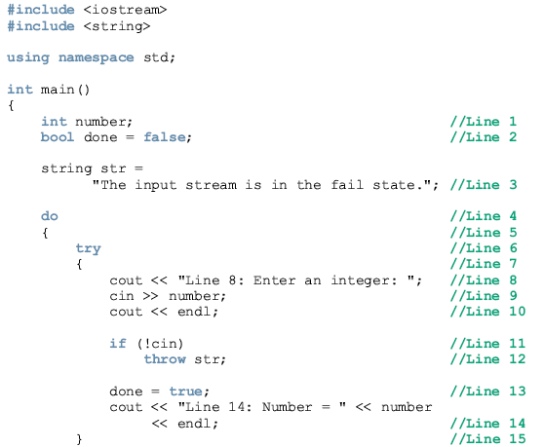
Example

Slide 59
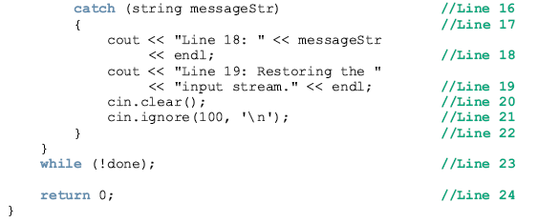

Slide 60
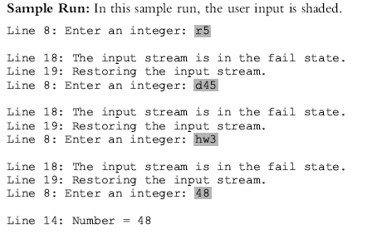

Slide 61
Log the Error and Continue
Example: if the program is designed to run a nuclear reactor or continuously monitor a satellite
  It cannot be terminated if an exception occurs
When an exception occurs
  The program should write the exception into a file and continue to run
C++ Programming: From Problem Analysis to Program Design, Sixth Edition

Slide 62
Stack Unwinding
When an exception is thrown in a function, the function can do the following:
  Do nothing
  Partially process the exception and throw the same exception or a new exception
  Throw a new exception
In each case, the function-call stack is unwound so that the exception can be caught in the next try/catch block
C++ Programming: From Problem Analysis to Program Design, Sixth Edition

Slide 63
Stack Unwinding (cont’d.)
When the function call stack is unwound:
  The function in which the exception was not caught and/or rethrown terminates
  Memory for its local variables is destroyed
Stack unwinding continues until:
  A try/catch handles the exception, or
  The program does not handle the exception
    The function terminate is called to terminate the program
C++ Programming: From Problem Analysis to Program Design, Sixth Edition

Slide 64
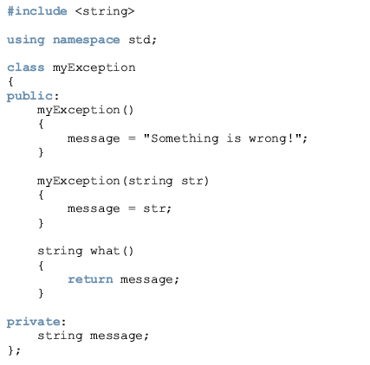

Slide 65
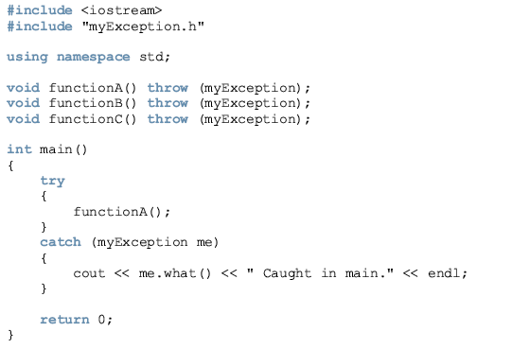
Example

Slide 66
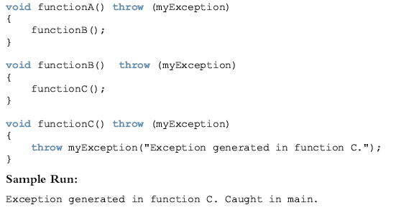

Slide 67
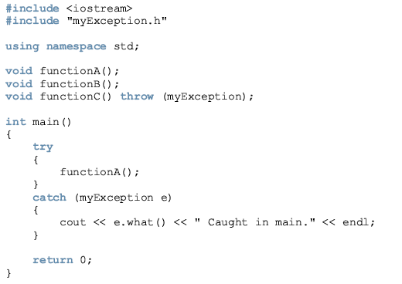
Example

Slide 68
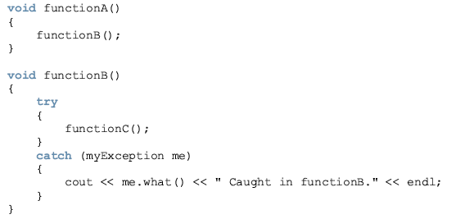
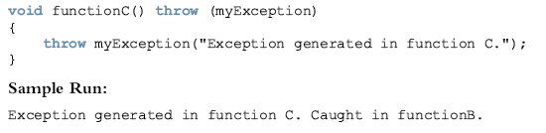

Slide 69
Summary
Exception: an undesirable event detectable during program execution
assert checks whether an expression meets a specified condition; terminates if not met
try/catch block handles exceptions
Statements that may generate an exception are placed in a try block
C++ Programming: From Problem Analysis to Program Design, Sixth Edition

Slide 70
Summary (cont’d.)
  catch block specifies type of exception it can catch and contains an exception handler
If no exceptions are thrown in a try block, all catch blocks for that try block are ignored
Data type of catch block parameter specifies type of exception that catch block can catch
C++ Programming: From Problem Analysis to Program Design, Sixth Edition

Slide 71
Summary (cont’d.)
exception: base class for exception classes
what function: returns a string containing the exception object thrown by built-in exception classes
You can create your own exception classes
A function specifies the exceptions it throws in its heading with the throw clause
C++ Programming: From Problem Analysis to Program Design, Sixth Edition

Slide 72
Summary (cont’d.)
If the program does not handle the exception, then the function terminate terminates the program
Any class can be considered an exception class, based on how it is used
C++ Programming: From Problem Analysis to Program Design, Sixth Edition

